Slide 1
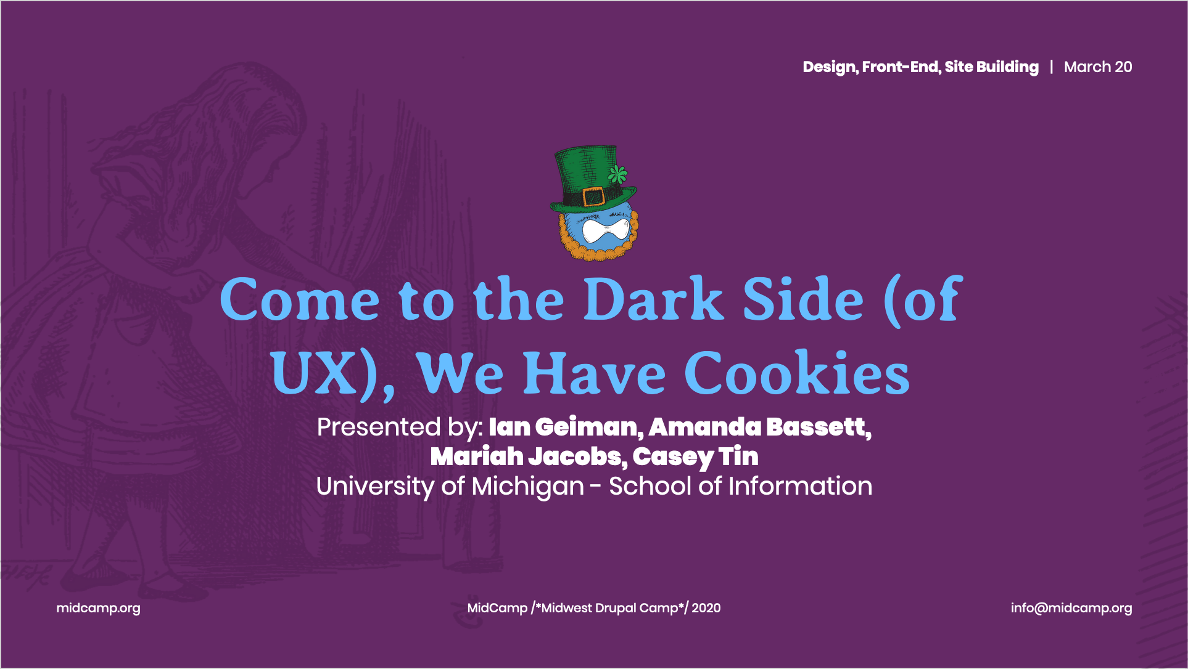

Slide 2
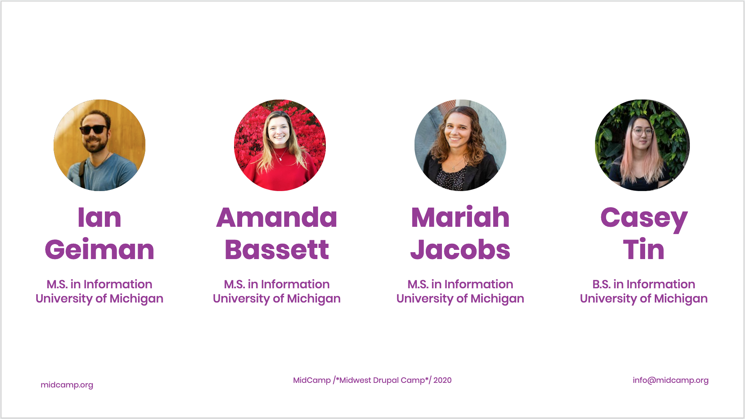
Notes:
My name is Ian, and I’m here with Amanda, Mariah, and Casey to speak to you today. We are all students at the University of Michigan studying user experience research and design.

Slide 3

Welcome to…
The Dark Side
Notes:
Welcome everyone…. to the dark side. I would my best Darth Vader impression but I don’t want to sound sick. Seriously though, I hope everyone is staying healthy and able to work from home and do some social distancing right now.
To those of you who are familiar with the field of usability and user experience, welcome back. If you haven’t heard of user experience, or UX, we’ll have a brief primer for you before we get into the dark side of things!
.

Slide 4

Questions:
sli.do
#midcamp
Notes:
I do have an unfortunate announcement to make - we originally planned this as a more interactive session with cookies and a back and forth with you all, but things are going to be a little different today as we are virtually doing this.
To make up for the lack of audience participation, we are using Slido, a tool that allows you to ask questions and let’s us have some interaction with you all. It doesn’t require an account to join, so please enter our meeting code, #midcamp at sli.do. I’ll give you a couple of moments to get that up, or stare at these cookies.

Slide 5
What is UX?
Notes:
Before we start, I’m going to talk about what user experience, or UX is.

Slide 6
Tell us a good experience:
#midcamp at sli.do
Notes:
Please take a moment to think of something you enjoy using, whether it be software or a physical product. Let us know on slido what you think of, I’ll give you a minute, with some music. (count down 30 seconds)

Slide 7
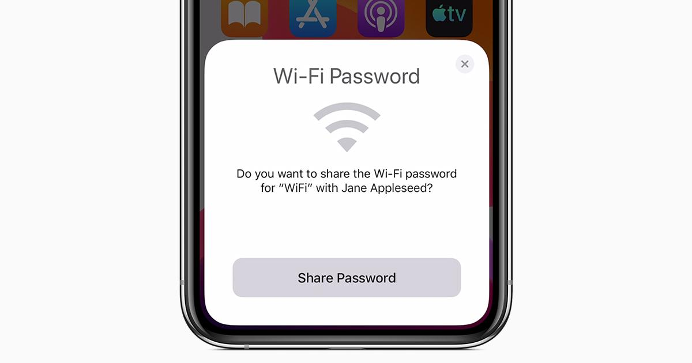
Image from apple.com
Notes:
One of my personal favorites is a feature that I wasn’t expecting and really impressed me the first time I used it. Apple’s wifi password sharing is such a small thing yet it saves time and hassle when people don’t know their wifi password.
If you haven’t used it, when someone new is trying to log into a wifi network and one of their contacts is already on that network, the person already on can share the wifi password, without actually exposing the password itself to their contact. Great for coffee shops and home networks.

Slide 8

Notes:
These experiences can be outside of software as well - another favorite of mine is using Fujifilm cameras for photography. They have such a familiar feel whenever I pick one up and start photographing with it. Everything is exactly where I think it should be, with the controls and dials all easily laid out in a way I can use them without looking at the camera.
The experience of using this camera, and any good product based experience you all thought of, was intentionally designed in some way for people to use.
The reason some of you may like a particular experience is that it is simply easy of use. It could be argued that the best user experience is one you don’t notice at all...

Slide 9
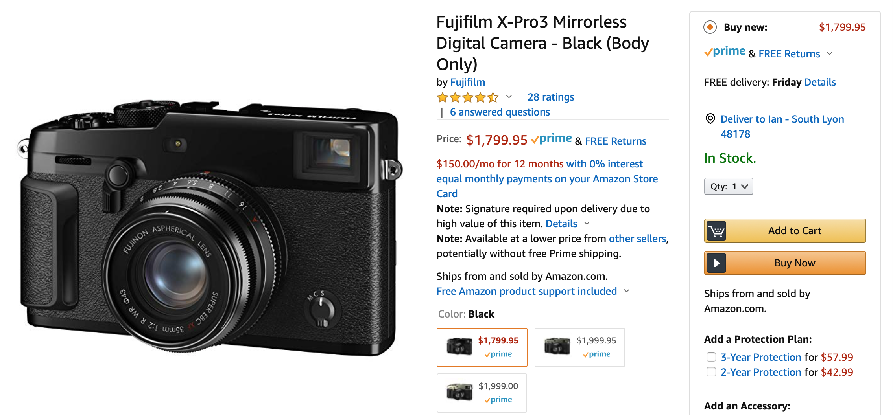
Notes:
Like an easy checkout process...

Slide 10
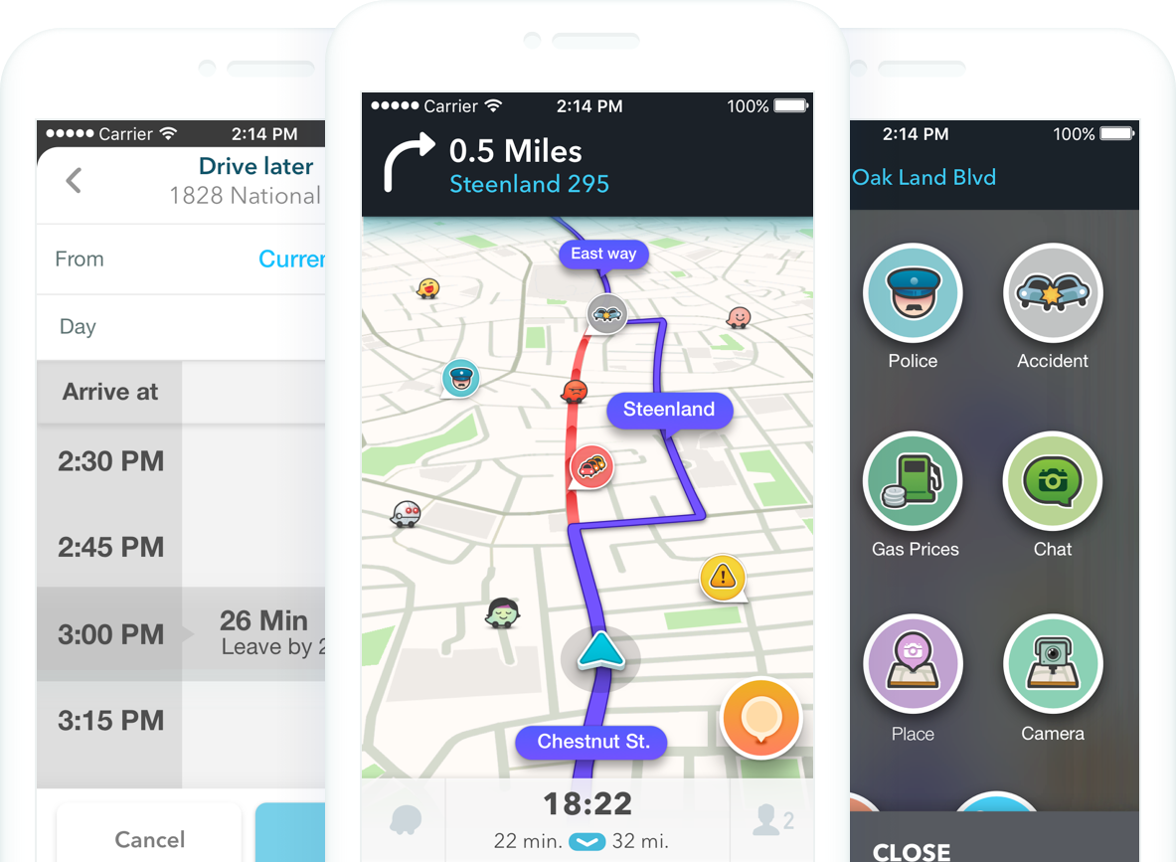
Image from waze.com
Notes:
A good maps application...

Slide 11

Notes:
Basically anything that works like you expect it to. This is all good user experience. Whether you notice it or not, UX is there to help get things done.

Slide 12
“User experience encompasses all aspects of the end-user's interaction with the company, its services, and its products.” - NN Group
Notes:
The Nielsen Norman group, a well known user experience organization, defines UX as encompassing all aspects of the end user’s interaction with the company, its services, and it’s products.
Anything we experience can be designed - as long as the person doing the designing understands how the end user thinks about things.

Slide 13
UX, or Human Centered Design
Notes:
In our industry, we use the term Human Centered Design to indicate our goal of making experiences that revolve around how we, as people, think about doing things.
As Nielsen and Norman pointed out, this can cover software, hardware, services, and even how people move through public spaces.

Slide 14
Does this work in the way I expect it to work?
Notes:
In its simplest form, UX means - does this thing work like I expect it to work?

Slide 15

Designing Experience
Notes:
So how does user experience happen? Ideally, when a product is being designed for the first time, that product is based on an actual user need.
A UX researcher or designer might be integrated into the product design process to better understand the need that the user has, and to make recommendations for product direction.

Slide 16
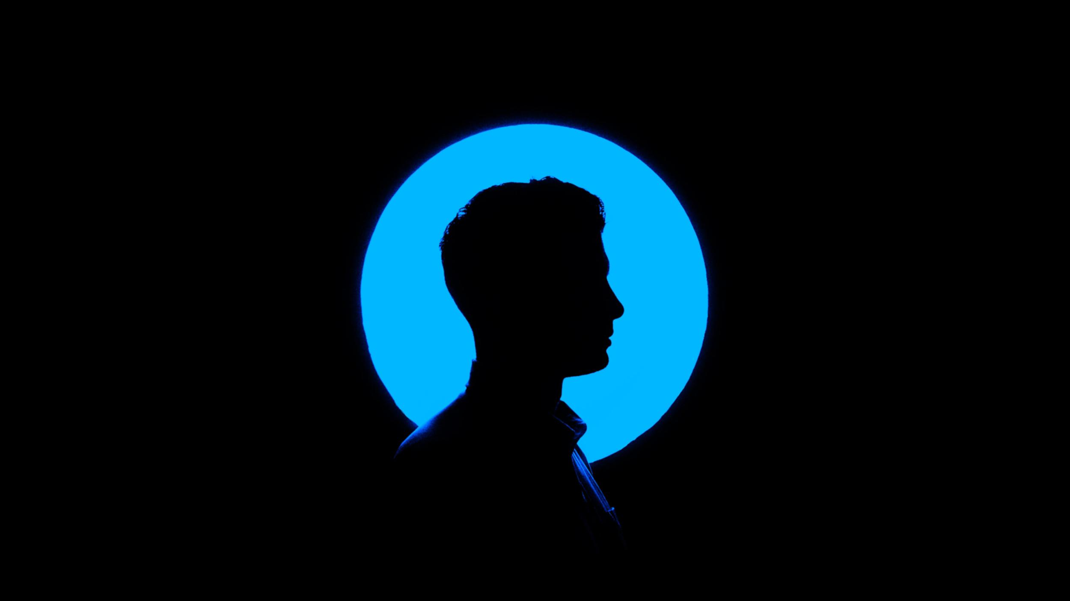
Notes:
All of that is to understand the mental model of the user, so the product can work like the user intends.
As soon as your product doesn’t work as intended, the user might get frustrated - and if a competitor is doing their UX better, that user might switch platforms based on that experience alone.

Slide 17

Notes:
But back to designing the product - once the mental model of the user is understood, the product can be made to match that model.
However, this can get complicated when you have many types of users - so some systems get built on commonalities between many types of stakeholders that have many differing needs.
UX works to balance all those needs and find the best way to handle them all.

Slide 18
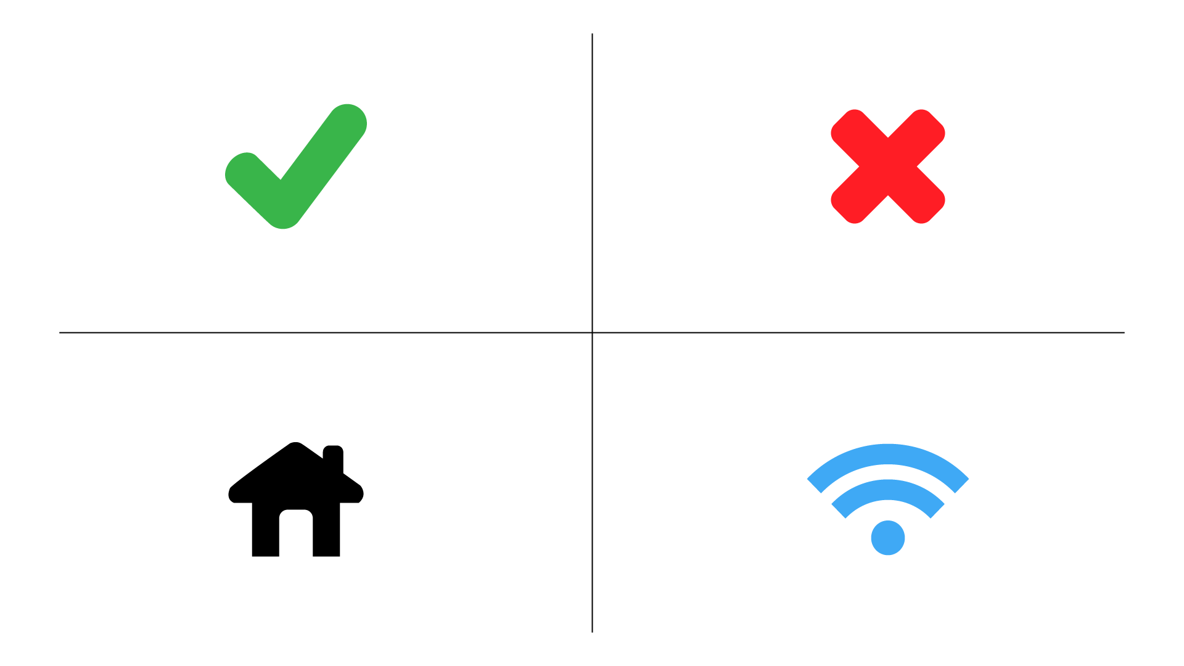
Notes:
These commonalities extend to how we all use virtual systems and interfaces - things like a check mark to confirm something, an ‘x’ to cancel, how certain icons are commonly understood (such as the home and wireless network icons) - these are all accepted standards in many cultures around the world.

Slide 19
What is Dark UX?
Notes:
So what is Dark UX ? You saw our punny session title and dropped in, wanting to learn more about it.
Well, the ‘dark side’ is everywhere - and it’s been around longer than you think.

Slide 20
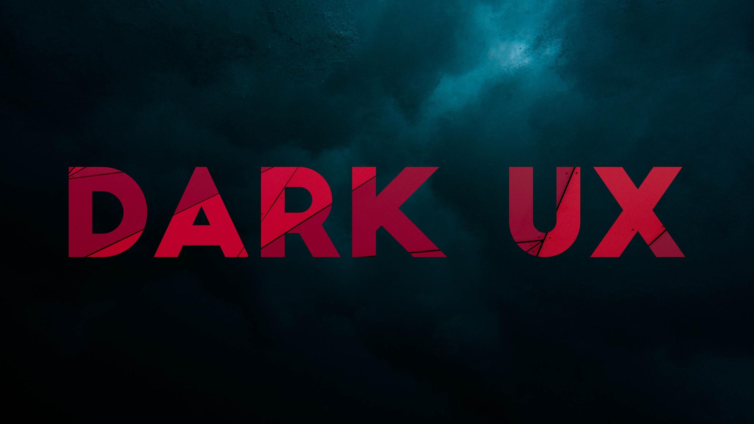
Notes:
Basically, Dark UX is the experience when using a product that tricks, coerces, or confuses users into putting their information or money somewhere they wouldn’t otherwise intend to.
These experiences are created with the intent to deceive or take advantage of users.
They are also known as Dark Patterns.
Some Dark UX is based on bad business practices, and when we get into specific examples you may be reminded of situations that you’ve experienced outside of software.

Slide 21
How is that different from Bad UX?
Notes:
Some of you may be thinking - well I’ve used some really annoying products before.
Annoying doesn’t mean the company is trying to intentionally profit off of you or steal your information - it could just be as simple as bad design, without enough thought put into it though.

Slide 22
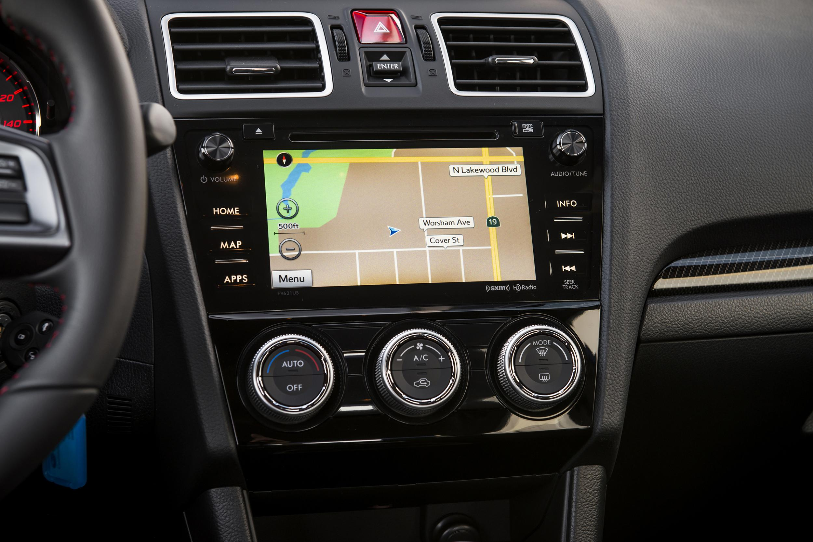
Automotive Software...
Notes:
Now, anyone that has jumped into an unfamiliar car and failed find something in an vehicle’s complicated menu system…. This is bad UX.
For example, this is a Subaru infotainment system, which was frustrating to use for many people.

Slide 23
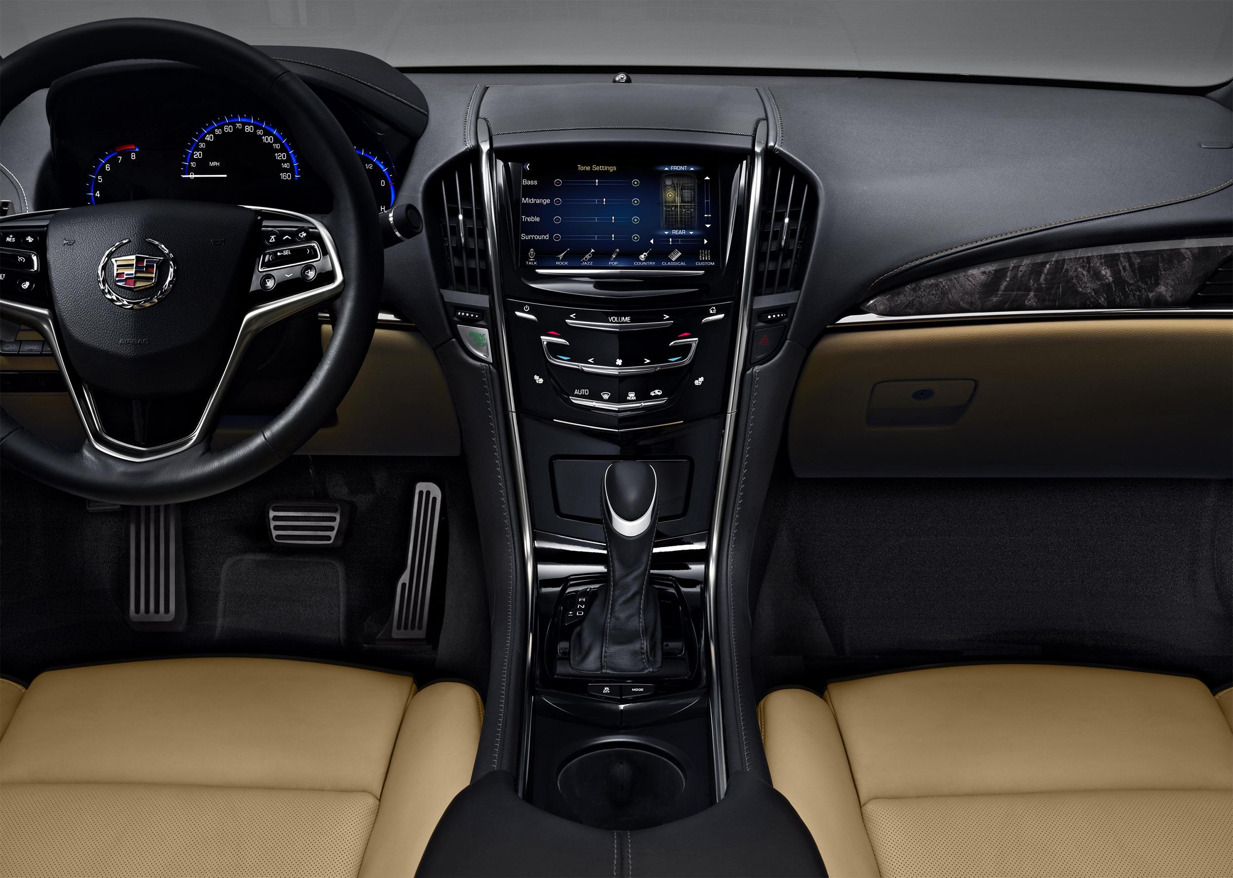
Automotive Software...
Notes:
Or, a feature gets added that is different than how people actually want to do things, which can have negative effects on the experience.
This is a Cadillac CTS interior, which was at one point criticized for taking away knobs for controlling functions and adding touch controls only.

Slide 24
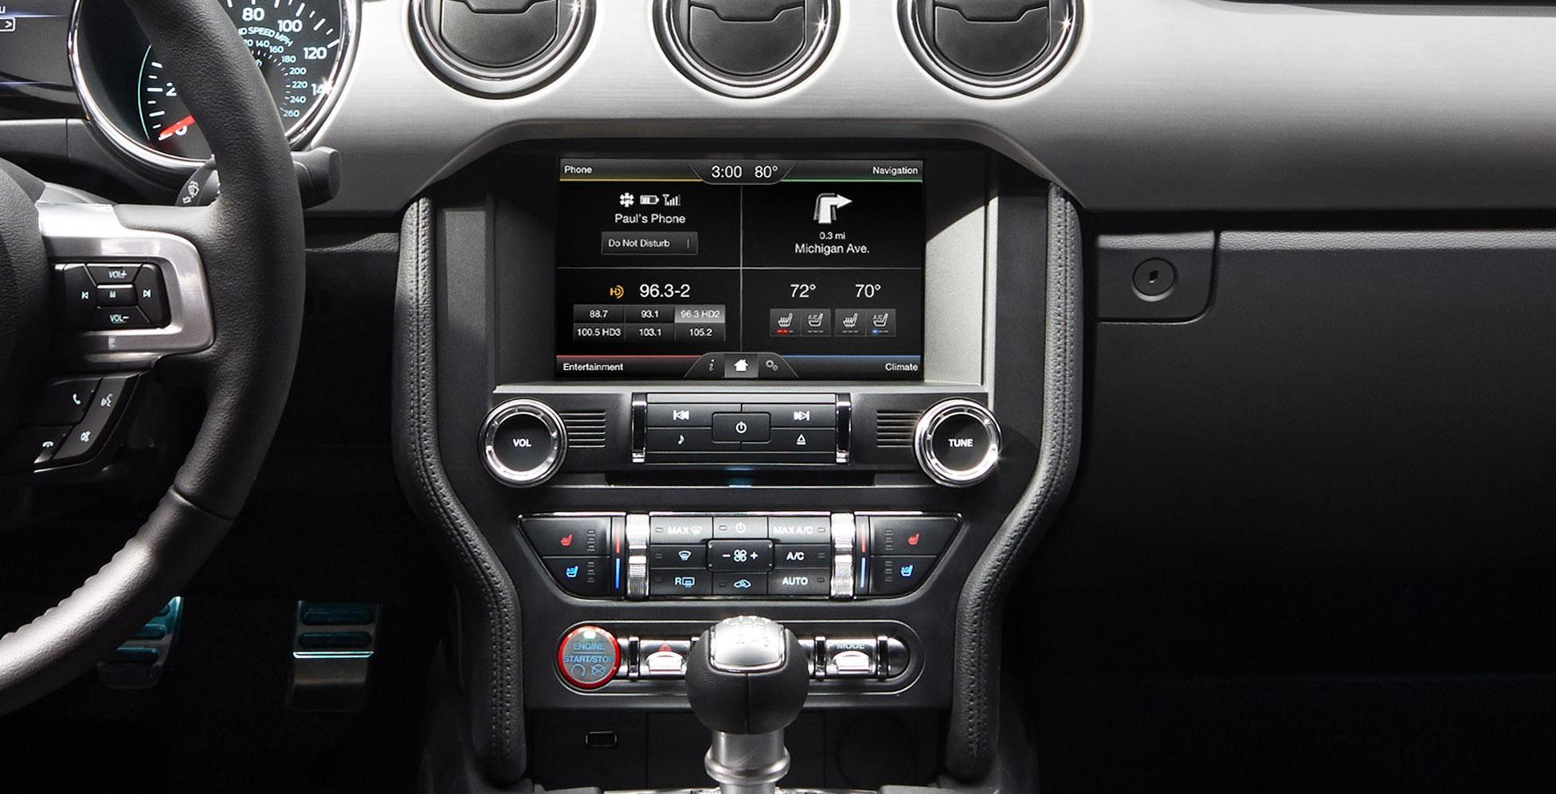
Automotive Software...
Notes:
There are a lot of reasons automotive user experience has been so historically poor over the years - trying to satisfy many types of customers, or just not having enough communication between the hardware and software teams.
This is the interior of a Ford Mustang, which at one point had an on-screen set of climate controls… doubled up right on top of the physical controls climate controls.
Thankfully we are starting to see that change in the UX in vehicles today. None of these design decisions were malicious, but they all impacted the user experience.

Slide 25
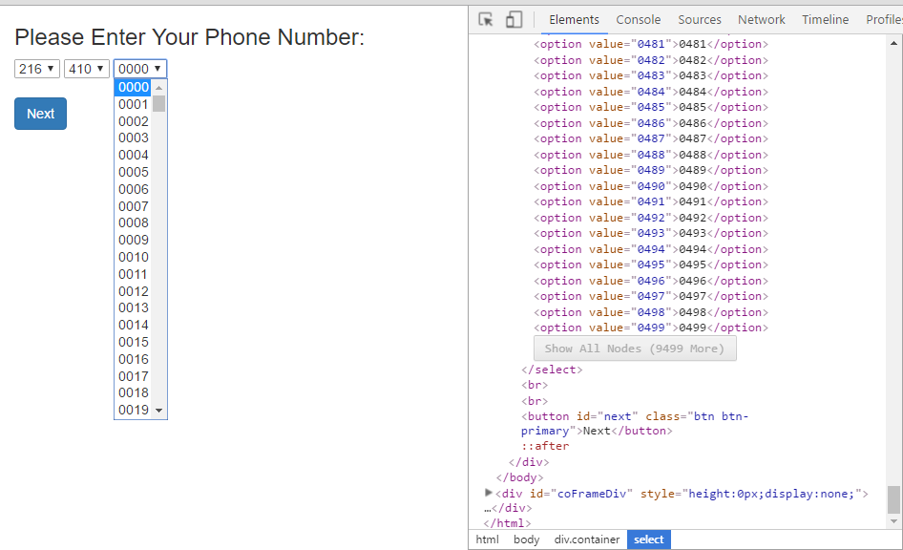
Notes:
Source links: https://imgur.com/a/4f3XB
A more humorous example of bad UX is this - frustrating phone number inputs. Lack of planning could have caused all of these frustrating phone number entry experiences to happen, due to too many conflicting stakeholders, red tape, or thoughtless design.
Thankfully, with something as simple as a phone number input, we worked through a good way to do that some time ago - and we don’t have to draw out our phone numbers, go through annoying dropdowns, or play number entry roulette.

Slide 26
Notes:
Source Links: https://imgur.com/a/eWbBK
Bad or uninformed UX could also cause these - the most frustrating volume sliders we could think of.
Now, I have to admit these are some favorite intentionally BAD user experiences on the internet, and if you want to see more search for purposely bad volume sliders.
Simply, bad UX happens all the time! It is, mostly, an accident with no malicious intent behind it. This happens by not understanding the user.

Slide 27
Notes:
But Dark UX occurs when the company understands how the user thinks, and uses that for their own profit.
The commonalities I mentioned before, between users, between cultures, and in interfaces we all use - can be leveraged against us.
Here are some of the types of Dark UX that have found their way into products we all know and interact with. I’ll turn this over to Amanda now.

Slide 28
Types of Dark UX
Notes:
Amanda (first 7) & Mariah (last 7)

Slide 29
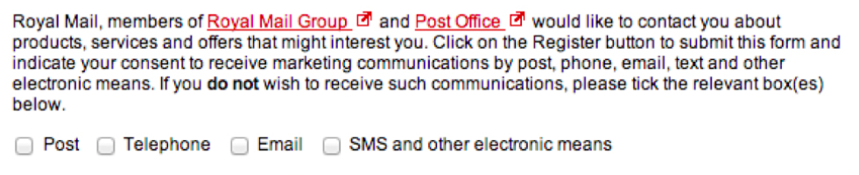
Trick Questions
While filling in a form, you respond to a question that tricks you into giving an answer you didn't intend. When glanced upon quickly the question appears to ask one thing, but when read carefully it asks another thing entirely.
Example: re-subscribe buttons when unsubscribing from mailing lists
From darkpatterns.org, image: theverge.com
Notes:
Amanda
https://www.theverge.com/2013/8/29/4640308/dark-patterns-inside-the-interfaces-designed-to-trick-you

Slide 30
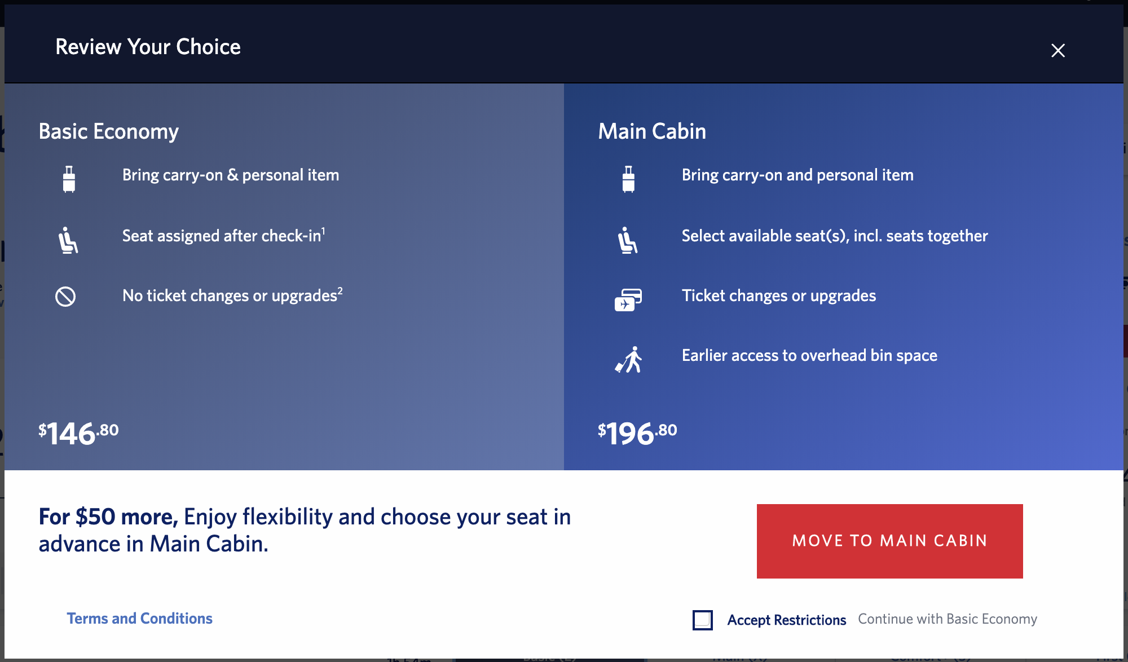
Sneak into Basket
You attempt to purchase something, but somewhere in the purchasing journey, the site sneaks an additional item into your basket, often through the use of an opt-out radio button or checkbox on a prior page.
Example: booking tickets on delta.com
From darkpatterns.org
Notes:
Amanda
Airline booking (when trying to choose the economy option)

Slide 31
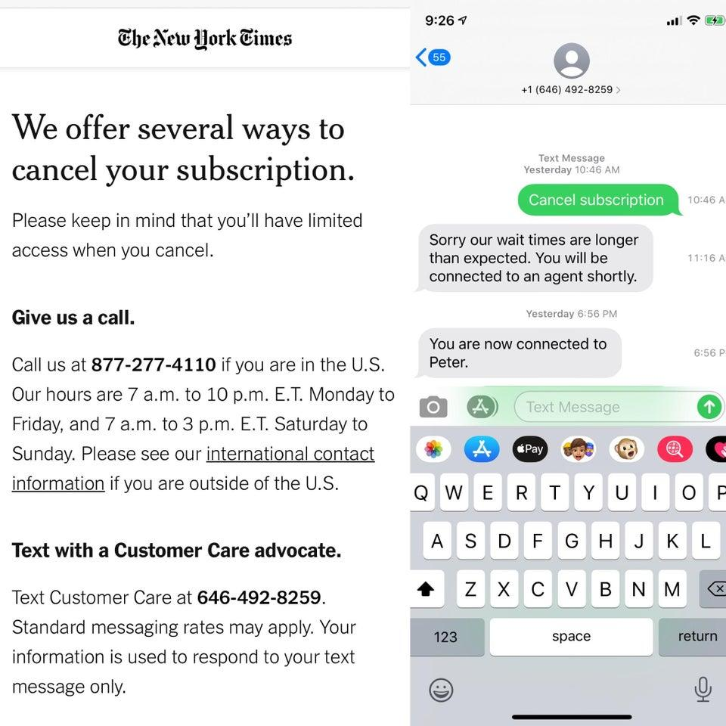
Roach Motel
You get into a situation very easily, but then you find it is hard to get out of it (e.g. a premium subscription).
Example: New York Times unsubscribe
From darkpatterns.org
Notes:
Amanda

Slide 32
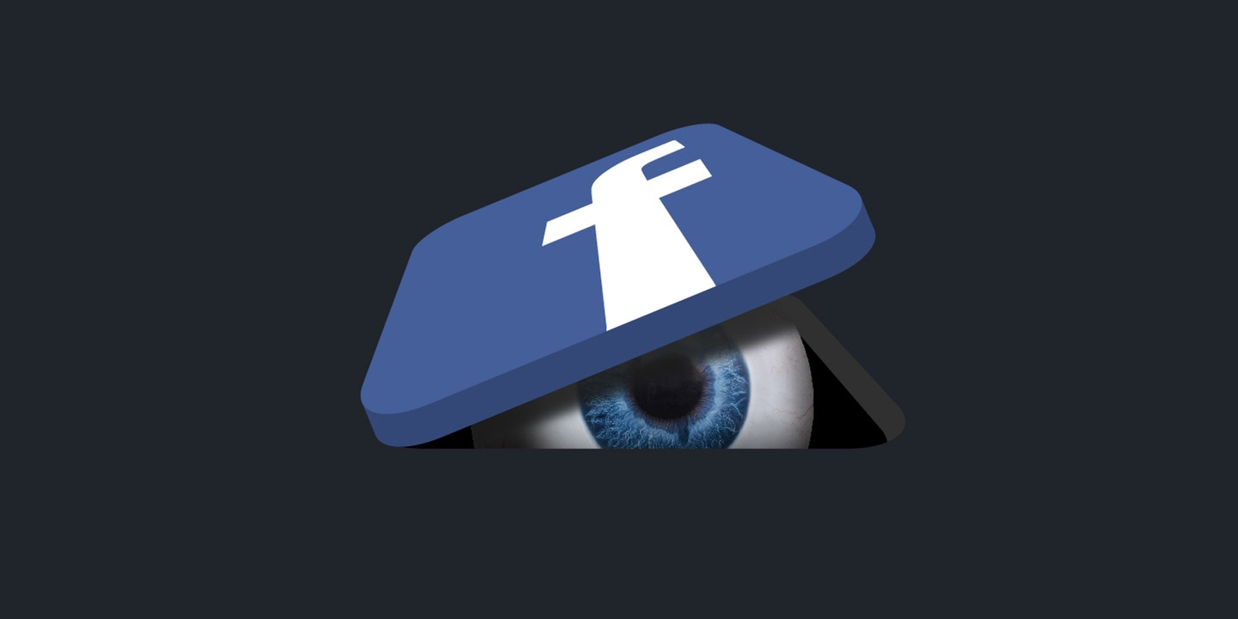
Privacy Zuckering
You are tricked into publicly sharing more information about yourself than you really intended to. Named after Facebook CEO Mark Zuckerberg.
Example: Facebook, all of it
From darkpatterns.org; photo illustration: Soohee Cho/The Intercept
Notes:
Amanda
**Data security

Slide 33
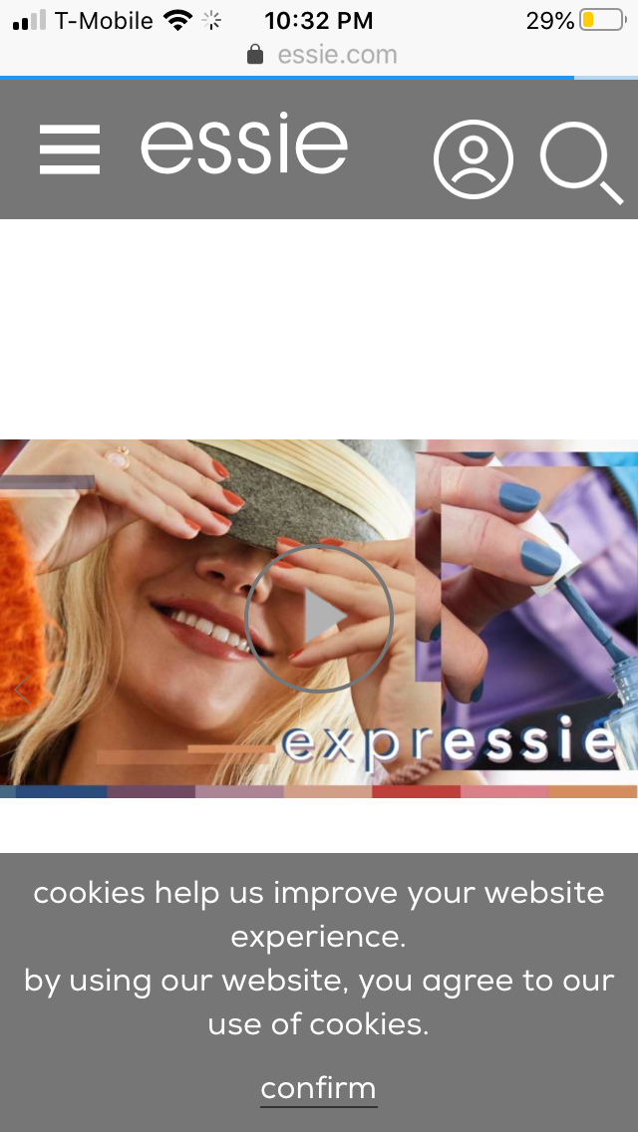
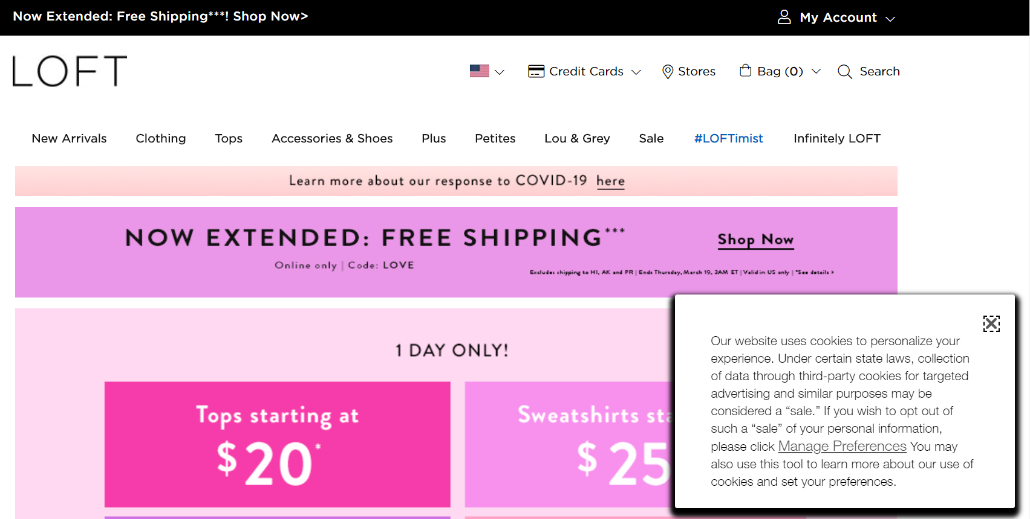
Speaking of cookies...
From darkpatterns.org
Notes:
Amanda
**Data security

Slide 34
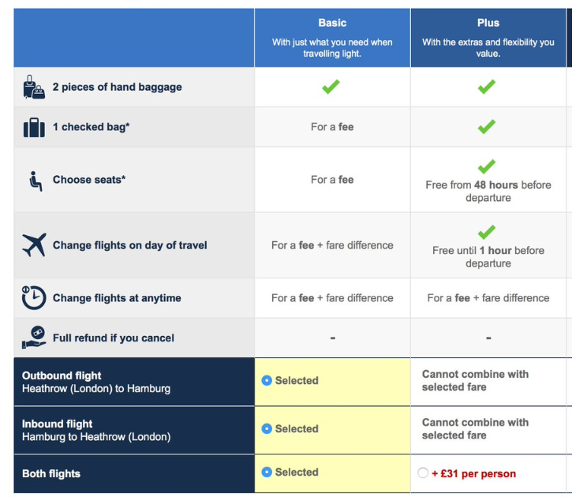
Price Comparison Prevention
The retailer makes it hard for you to compare the price of an item with another item, so you cannot make an informed decision.
Example: British Airways Fares
From darkpatterns.org, image: econsultancy.com
Notes:
Amanda
Ladders lets you create a free account but requires you to have a premium subscription to browse a majority of the job postings as well as to apply to a job, but the intention of the website is to help users find jobs.

Slide 35
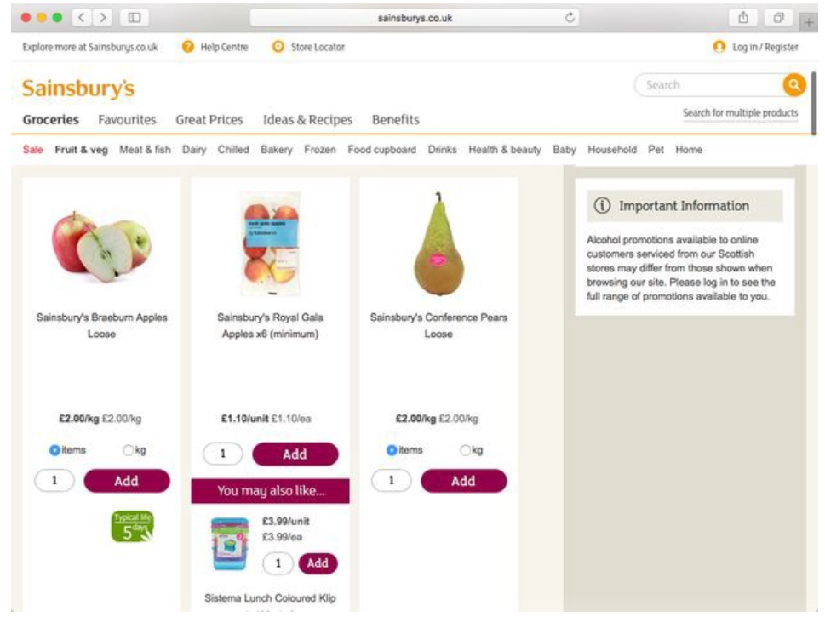
Price Comparison Prevention
The retailer makes it hard for you to compare the price of an item with another item, so you cannot make an informed decision.
Example: Comparing prices on Sainsbury.com
From darkpatterns.org, image: medium.com
Notes:
Amanda
Sainsbury’s.com

Slide 36
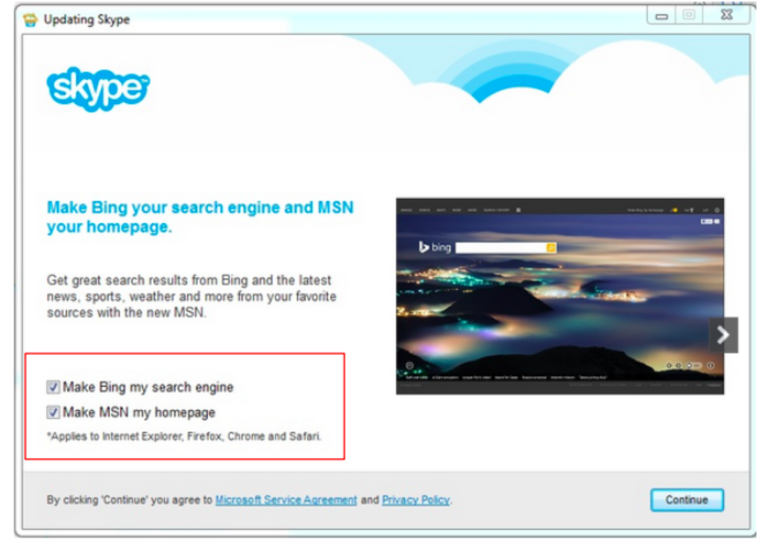
Misdirection
The design purposefully focuses your attention on one thing in order to distract your attention from another.
Example: Skype setup
From darkpatterns.org, image: medium.com
Notes:
Amanda
**Also an example of Sneak Into Basket

Slide 37
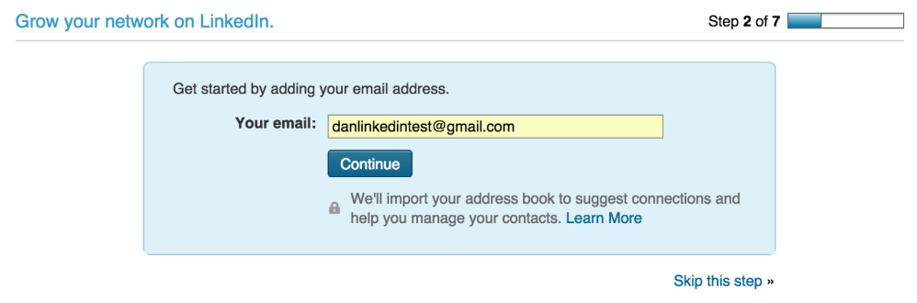
Friend Spam
The product asks for your email or social media permissions under the guise of a desirable outcome (e.g. finding friends), but then spams all your contacts in a message that claims to be from you.
Example: LinkedIn
From darkpatterns.org, image: medium.com
Notes:
Amanda

Slide 38
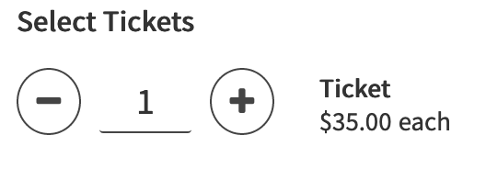
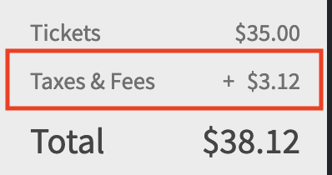
Hidden Costs
You get to the last step of the checkout process, only to discover some unexpected charges have appeared, e.g. delivery charges, tax, etc.
Example: Portland* Escape Rooms
*Oregon has no sales tax.
From darkpatterns.org
Notes:
Mariah
Thanks Amanda. Unfortunately, but maybe fortunately for this presentation, there are still more UX dark patterns. (So, I’m Mariah and) I’ll be picking up with where Amanda left off…
Hidden Costs are another UX dark pattern. This one is pretty self explanatory, and it’s probably something that we’ve all experienced. You’re about to checkout, finally in the last steps of the process, you’re hit with some extra fines or fees -- which probably don’t have any explanation.
Here’s one example from this: back in December, we actually paid money to be stuck inside a room -- which is a very different situation than we’ve found ourselves in this past week. In December, I was booking an escape room in Portland, Oregon for a group of friends.
To start the booking process, I selected the number of tickets that I wanted. As the top image on this slide shows, I have one ticket and there is a description under the word “Ticket” saying that they are “$35.00 each”. When I went to finalize the booking, I was hit with a screen similar to this one. (Only, that booking was for more people so it was a larger tax.) The second image here shows an itemized list of my purchase. My tickets are listed for $35.00, and then there is something marked “Taxes and Fees” for an additional $3.12 per ticket. This magic tax appeared and was added to my total during the final step of the booking process! It’s important to note that Oregon has no sales tax, so that wasn’t an explanation for this. There wasn’t an explanation. And that is an example of a hidden cost dark pattern.

Slide 39
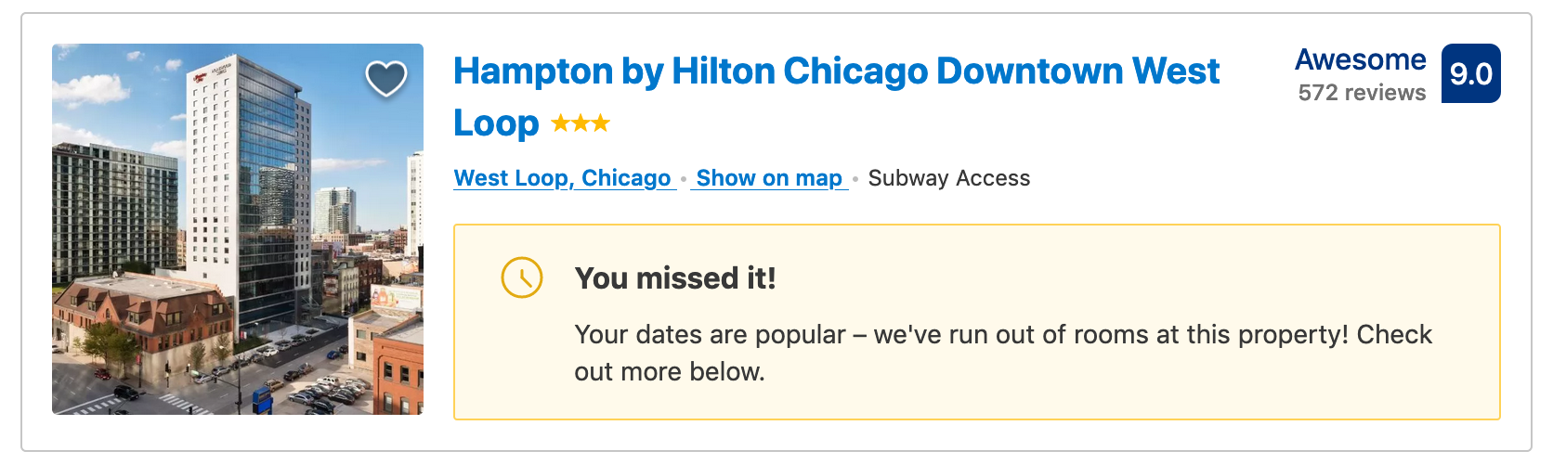
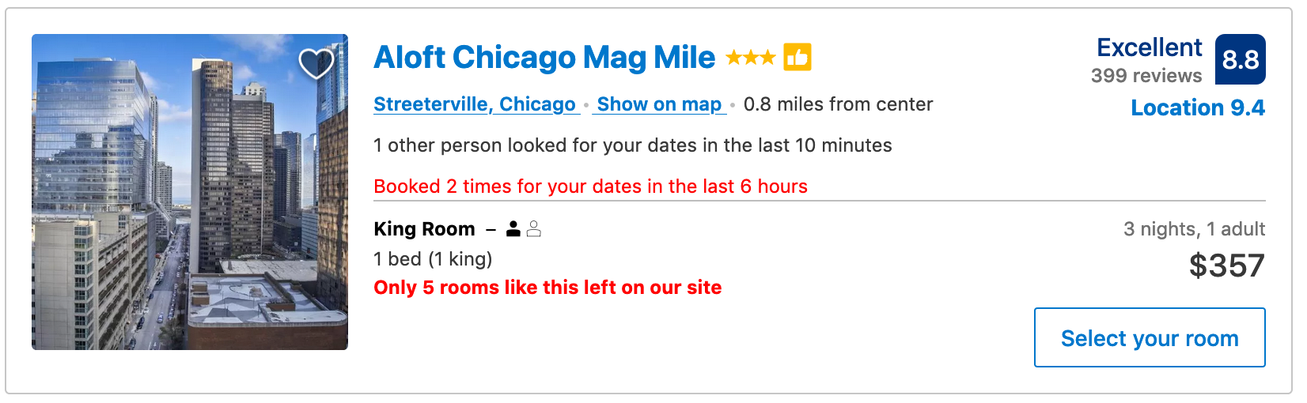
The Final Countdown
You are pressured into buying something by a counter indicating how many of the item are left in stock, or how long until your cart expires.
Example: Booking.com
Notes:
Mariah
This next dark pattern is one that I named, though another name for it might exist somewhere out there. I call it the The Final Countdown because it’s what websites use to pressure you into thinking that time is running out. This creates perceived scarcity. This is a common tactic with travel sites, like the example of Booking.com that we see here. In the top image, there is a booking that no longer exists -- yet the website chose to display it anyway because they want you to know what you missed out on. In the bottom image, there is a warning in red text that lets you know that the number of bookings is limited -- so you better act fast.
Other online retailers outside the travel industry use this, too. Etsy, the e-commerce site for crafts, uses this strategy… which is not somewhere I’d necessarily expect.

Slide 40
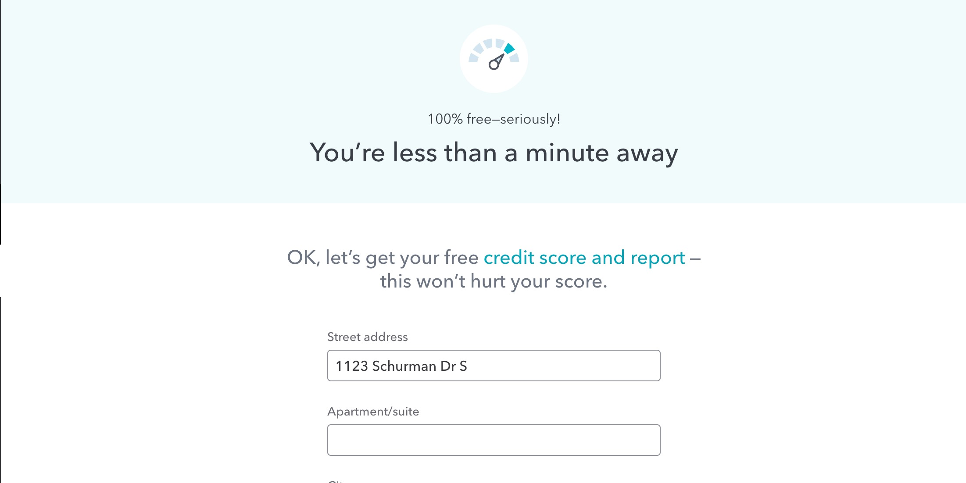
Bait & Switch
You set out to do one thing, but a different, undesirable thing happens instead.
(Also: you are initially offered one thing, and then offered a different thing, at a higher cost, instead.)
Example: TurboTax
From darkpatterns.org
Notes:
Mariah
https://usertimes.io/2019/02/01/bait-and-switch/
Bait and Switch is a UX dark pattern that actually originated in marketing. It’s described as when you set out to do one thing, but a different, undesirable thing happens instead. An example of this is if you go to purchase something, but when you try, you are offered a different thing, at a higher cost, instead.
The example I have here is TurboTax, because my friend recently mentioned the experience she had as she was trying to file her taxes. In the image on the right,
**Privacy Zuckering applies here, as well.

Slide 41
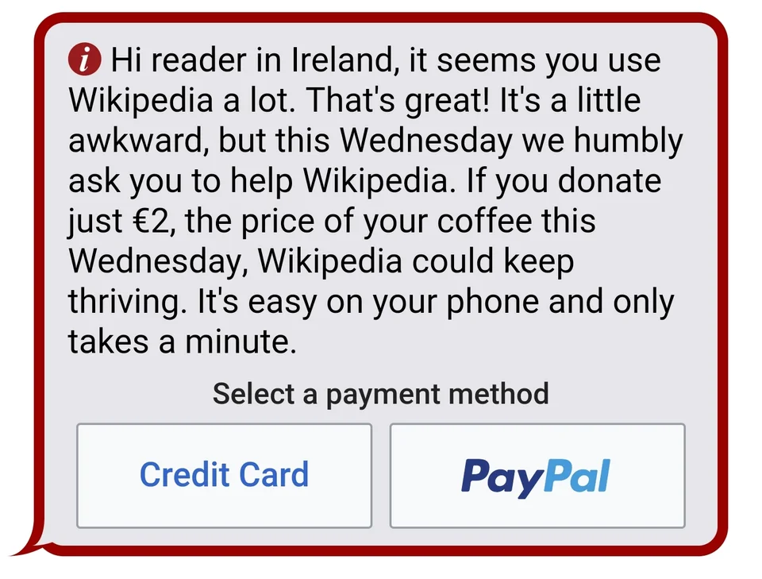

Confirmshaming
The act of guilting the user into opting into something. The option to decline is worded in such a way as to shame the user into compliance.
Example: disabling adblockers or donating to Wikipedia
From darkpatterns.org, photocredits: M3rryP3rry (reddit) and confirmshaming.tumblr.com
Notes:
Mariah
Confirmshaming is a fun example of how dark UX directly tries to emotionally manipulate you by guilting users into opting into something. They do this by including a decline option that is worded in such a way that you’re more likely to just agree and confirm what they’re asking, rather than reject the offer.
One example of this is Wikipedia around the holiday times. They post large banners as requests every time you land on the site that ask you to donate. In this top image here, which asks the user for a donation, they actually don’t include a decline button at all -- the user is just offered two payment options (one button for Credit Card and another for Paypal), even though a donation isn’t mandatory.
The second image is an example of one of those forced email subscriptions that tries to sign you up for a mailing list, in this case the Free Beginners Garden Guide. There’s a textbox for an email address and a big red button that says “Get Your Free Guide”. You can see at the bottom that there’s small text saying “No thanks, I know everything about gardening.” Not only is it tiny and easy to miss, but it’s worded as a flippant response, which makes you more likely to do the polite thing and subscribe.

Slide 42
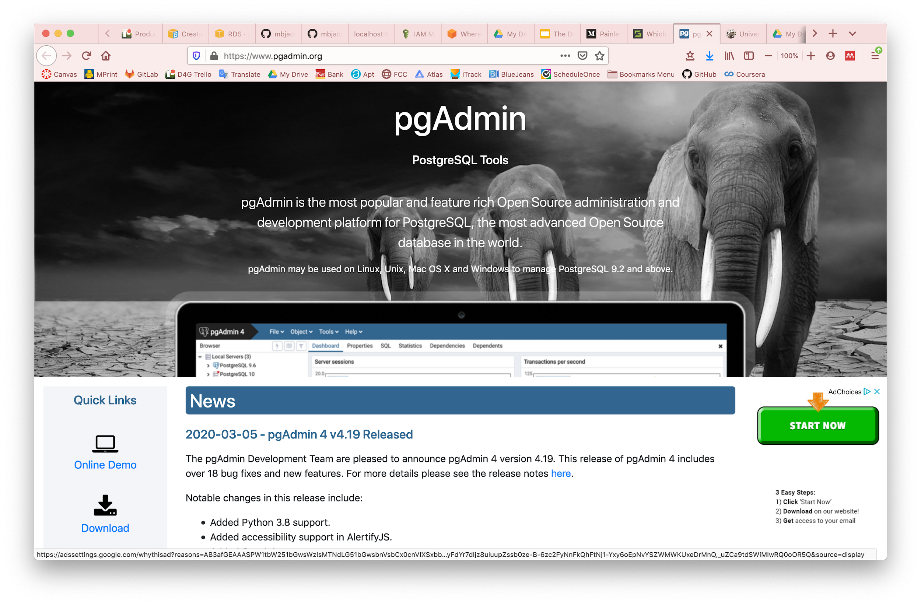
Disguised Ads
Adverts that are disguised as other kinds of content or navigation, in order to get you to click on them.
Example: “Download” or “Play” buttons that redirect to another site
From darkpatterns.org
Notes:
Mariah
If you’ve ever played a game on a website or mobile device, or navigated to a download page for some software, you’ve probably run into disguised ads.
These are a UX dark pattern because they are designed to look like something that would make sense on the page -- like a download button -- but if you look closer, they’re actually an advertisement and clicking one will redirect you to who knows where.

Slide 43

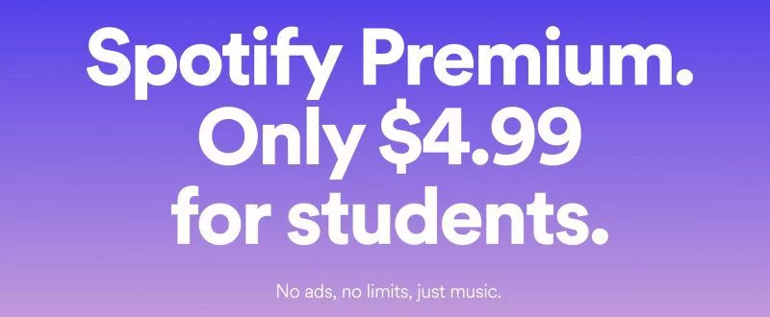
Forced Continuity
When your free trial with a service comes to an end and your credit card silently starts getting charged without any warning. In some cases this is made even worse by making it difficult to cancel the membership.
Example: Amazon Prime or Spotify Premium Student
From darkpatterns.org
Notes:
Mariah
Another UX dark pattern that we’ve all probably fallen victim to at one time or another is forced continuity. Maybe you didn’t know the name for it. I didn’t know the name for it either, before I came to the dark side.
This strategy is used by businesses who have lured you in with a free or discounted trial, but with the catch that you’ll pay full price for the service after a certain time period elapses. This means the dreaded entering of your credit card number upon signing up. And of course, they are unlikely to *remind* you when your free or reduced trial period ends.
Audible, Amazon Prime, and Spotify Premium Student are subscription services that are likely to get ya at some point. I most recently went through this battle with Spotify in December when they told me my student account was expiring because my four years were up. This is when I learned that Spotify hates grad students. Even if you enter another email address (like my new, valid Umich email) on that same account, their policy is apparently that you can only be a student for four years. (I did end up finding a workaround for this, by the way.)
But the point here is: subscription services, especially, love to trap you with forced continuity. Once you’re on a trial period of a service, there’s a good chance that they can get you to pay for the full service.

Slide 44
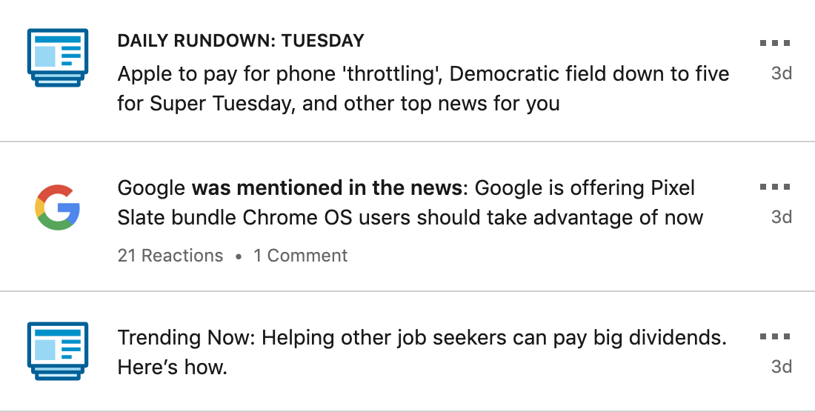
Irrelevant Notification Overload
The product attempts to lure you back to the application by notifying you of information that does not actually matter or pertain to you.
Example: LinkedIn notifications
From designlab.com
Notes:
Mariah
Facebook also does this.

Slide 45
Let’s use your new knowledge!
(on sli.do - #midcamp)
Notes:
Quiz type thing - music in BG per slide?

Slide 46
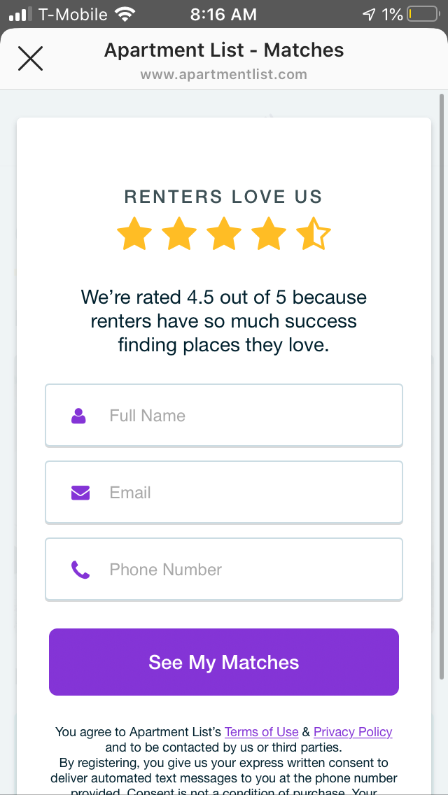
What type of Dark UX is this?
What type of dark UX is this?
The product leads you through a lengthy process of inputting your desired parameters for an apartment, then requires you to enter your email and phone number and agree to be contacted by third parties before you can view matches.
Notes:
45 seconds?
Privacy zuckering - you are basically being forced to hand out information. When I used this, I had no idea that third parties would contact me and received annoying phone calls from random apartments that kept calling me!

Slide 47
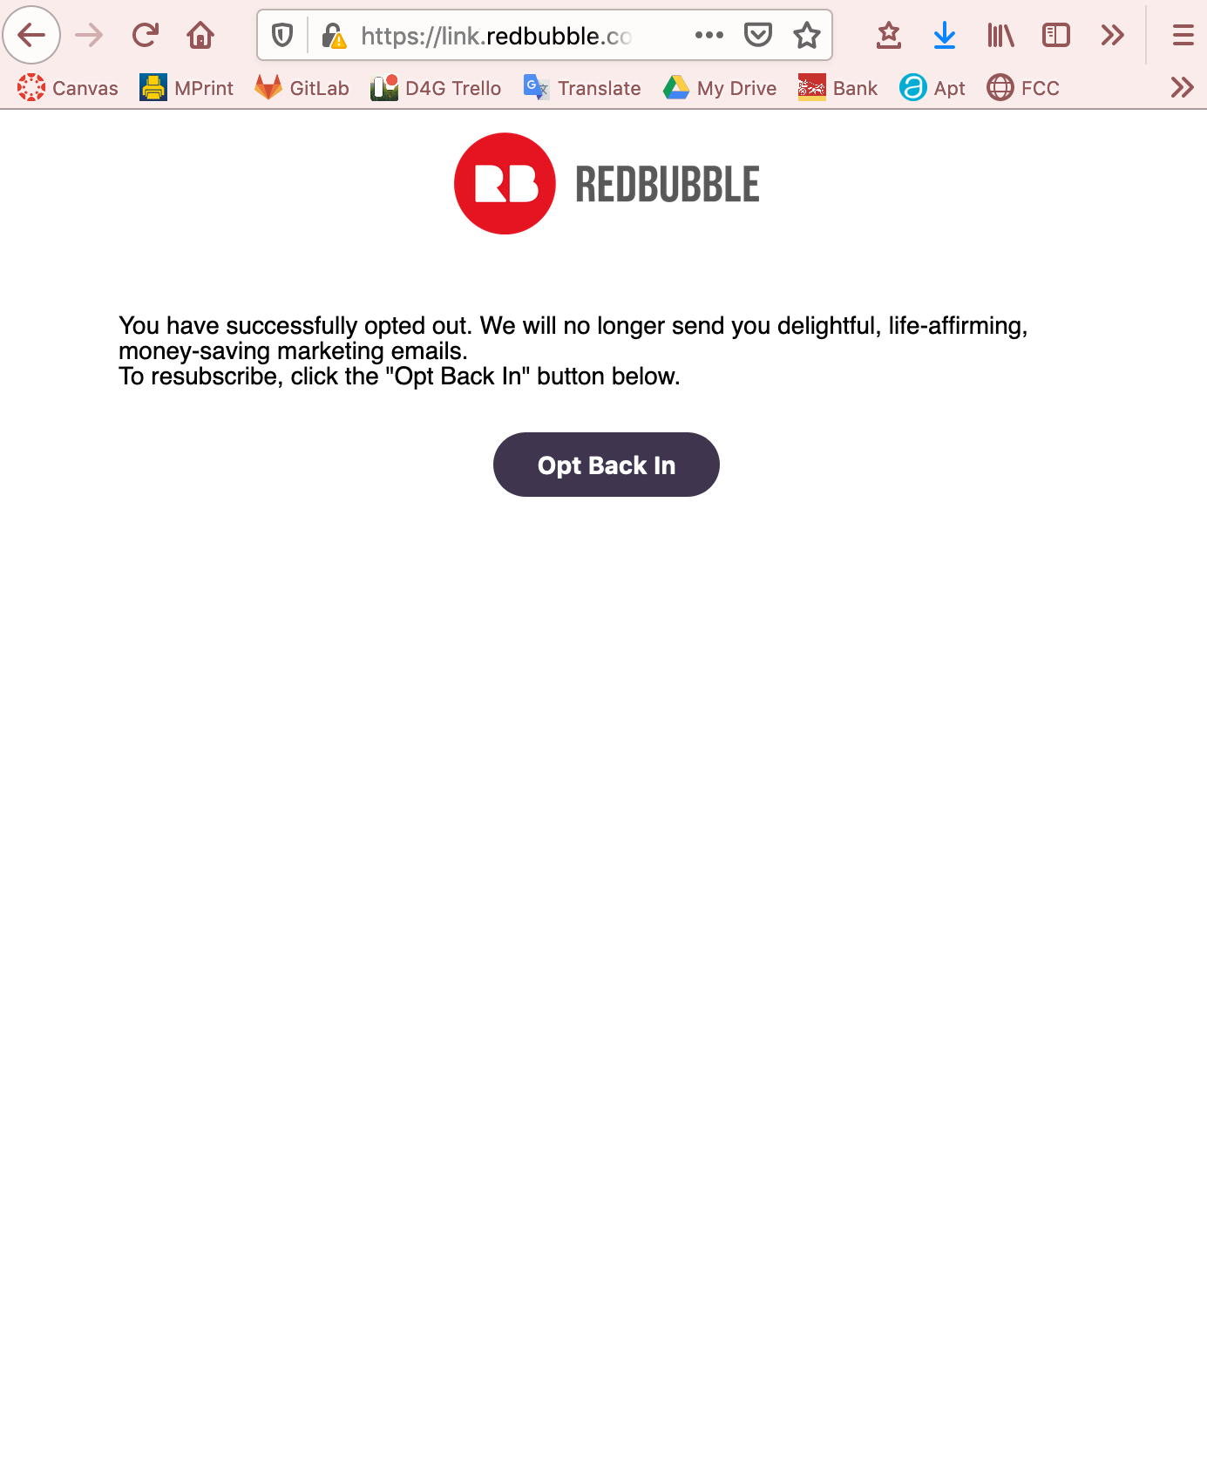
What type of Dark UX is this?
What type of dark UX is this?
This website’s unsubscribe feature isn’t the worst ever, but it does hide the confirmation that you’ve opted out in a paragraph of text.
The “Opt Back In” button is the prominent feature on the page, which makes users who are in a hurry/not reading carefully likely to click it.
Notes:
45 seconds?
Misdirection

Slide 48
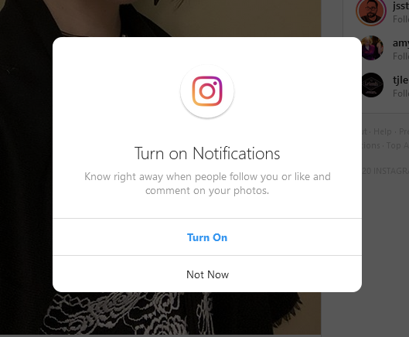
What type of Dark UX is this?
What type of dark UX is this?
If you turn off your notifications on Instagram, the app bothers you to turn them back on again, and again..
Even if this is what the user wants, they are constantly reminded of their choice.
Notes:
45 seconds?
Confirm shaming

Slide 49
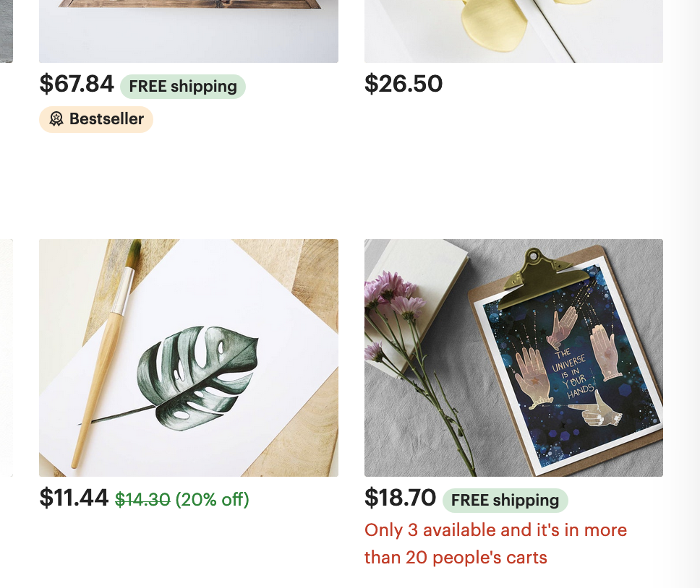
What type of Dark UX is this?
What type of dark UX is this?
This website is attempting to pressure its shoppers into making a purchase based on perceived scarcity of an item.
There is text that claims “only 3 available and it’s in more than 20 people’s carts”.
Notes:
45 seconds?
The Final Countdown

Slide 50
Hanlon’s Razor
Notes:
Mariah
Thanks for reviewing those dark patterns with us! Next Casey is going to talk about how to spread awareness of dark UX.
Casey
So we’ve seen some common examples of Dark UX in practice. You might be wondering why it is still seen so frequently. Oftentimes, dark UX practices are implemented as a result of shady business practices that try to manipulate users. In some cases however, the intention behind the user experience is not meant to be harmful. Sometimes dark UX is implemented due to lack of attention, or insufficient user testing that informs a designer of the impact of their choices.
This idea can be explained by Hanlon’s Razor, which is a philosophical concept that provides the mental model as shown in the next slide.

Slide 51
“Never attribute to malice that which is adequately explained by stupidity.”
Notes:
Casey
“Never attribute to malice that which is adequately explained by stupidity.”
To rephrase, UX that might seem harmful might not always be intended to. Sometimes designs that follow dark UX patterns are due to bad design!
We should remember that humans are prone to error and can’t get everything right the first time around. We see this all the time in the media, with fake news. For example, users were outraged with YouTube’s content policies, where videos with LGBTQ+ content were filtered to restrictive viewing, but this was an algorithm error on YouTube’s part.

Slide 52
What is being done?
Notes:
Casey

Slide 53
Research
Financial Times Magazine (May 2019): When manipulation is the digital business model
Gizmodo (April 2019): Senators Introduce Bill to Stop 'Dark Patterns' Huge Platforms Use to Trick Users‍
Purdue University UX Pedagogy and Practice Lab (Apr 2019): UXP2 Dark Patterns‍
Norwegian Consumer Council (June 2018): Deceived by Design: How Tech Companies Use Dark Patterns to Discourage Us From Exercising Our Rights to Privacy (PDF)‍
UX Podcast (February 2017): #150 Dark Patterns with Harry Brignull‍
Fast Company (December 2016): The Year Dark Patterns Won‍
The New York Times (May 2016): When Websites Won’t Take No for an Answer‍
The Verge (Aug 2013): Dark Patterns: inside the interfaces designed to trick you‍
Ars Technica (Jul 2016): Dark Patterns are designed to trick you (and they’re all over the Web)‍
Reddit: Dark Patterns and Asshole Design‍
UX Brighton 2010 Conference Video: Dark Patterns: User Interfaces Designed to Trick People
90 Percent of Everything (July 2010): Dark Patterns - Dirty Tricks Designers Use to Make People Do Stuff (the blog post that started all this).
A List Apart (November 2011): Dark Patterns: Deception vs. Honesty in UI Design
Smashing Magazine (March 2018): Ethical Design: The Practical Getting-Started Guide
Trine Falbe, Kim Andersen & Martin Michael Frederiksen (Late 2017): White Hat UX eBook
Smashing Magazine (April 2019): Privacy UX: Common Concerns And Privacy In Web Forms, Better Cookie Consent Experiences, Better Notifications And Permission Requests‍
Dataethics.eu: Data Ethics Tools for Companies and Organisations‍
Ethical.net: Ethical Alternatives & Resources‍
Notes:
Casey
The UX industry and research institutions are making efforts to explain what dark UX is, as well as bring awareness to dark UX patterns. We’ve included a few examples of what others are doing to mitigate the usage of dark UX.
As we can see from some of these sources, dark patterns have been around for a long time. The Verge published an article back in 2013 to bring awareness to the topic, yet it is still widespread across business practices.
In recent years though, many efforts have been made to mitigate the usage of dark patterns. As of April 2019, senators in Virginia and Nebraska have passed bills that forbid the usage of dark patterns to trick users. A draft of the bill notes that it is “illegal for large, public online services of more than 100 million monthly active users to “design, modify, or manipulate a user interface with the purpose or substantial effect of obscuring, subverting, or impairing user autonomy, decision-making, or choice to obtain consent or user data.””

Slide 54
What can we do?
Notes:
*** Using more images than text, and read from speaker notes
Casey
So Dark UX is more prevalent than you might think. But what can we do on our part?
The best way to avoid being “trapped” by dark UX patterns is to spread awareness about them. Spreading awareness will help others identify patterns more easily, which can lead to actions taken against these practices.

Slide 55
For your users
Notes:
Casey
First and foremost, your users.

Slide 56

Notes:
Casey
These are the people that you should be most concerned about, as they are directly impacted by dark UX practices. It is important to assess their user experience. If they express that something doesn’t feel right, it might be an indicator of dark UX patterns.

Slide 57

Notes:
Casey
As people who aim to deliver good user experiences, we should be cognizant of how our design choices influence the spread of dark patterns. If you are a designer in industry, for example, you might be asked to work on a feature that aligns with a dark pattern. Before taking on this work, it is important to ask why this feature is being implemented in this way. Point to the research surrounding the topic to provide a backing for your argument.
Dark patterns are not meant to be in favor of the user. We want to ensure that our users are satisfied, because happy users are long-term users and unhappy users are short-term users. Happy users will result in long term user engagement.

Slide 58
For yourself
Notes:
Casey
Next, what you can do for yourself.

Slide 59

Notes:
Casey
Apart from your users, being aware of how you as a user can be affected by dark patterns is essential.
You should be aware of situations and scenarios that feel Dark UX-y. You can start by identifying the patterns discussed earlier, or doing your own research about what other patterns exist and examples of where they are implemented. If you don’t feel comfortable about a situation that involves Dark UX, get out of that situation.

Slide 60

Notes:
Casey
As a user, it is also important to be aware of how your information is being handled. You should keep note of where your data goes and what it is used for, and how your money is being handled. For the sake of user privacy, it is important to voice these concerns and stay protected.

Slide 61
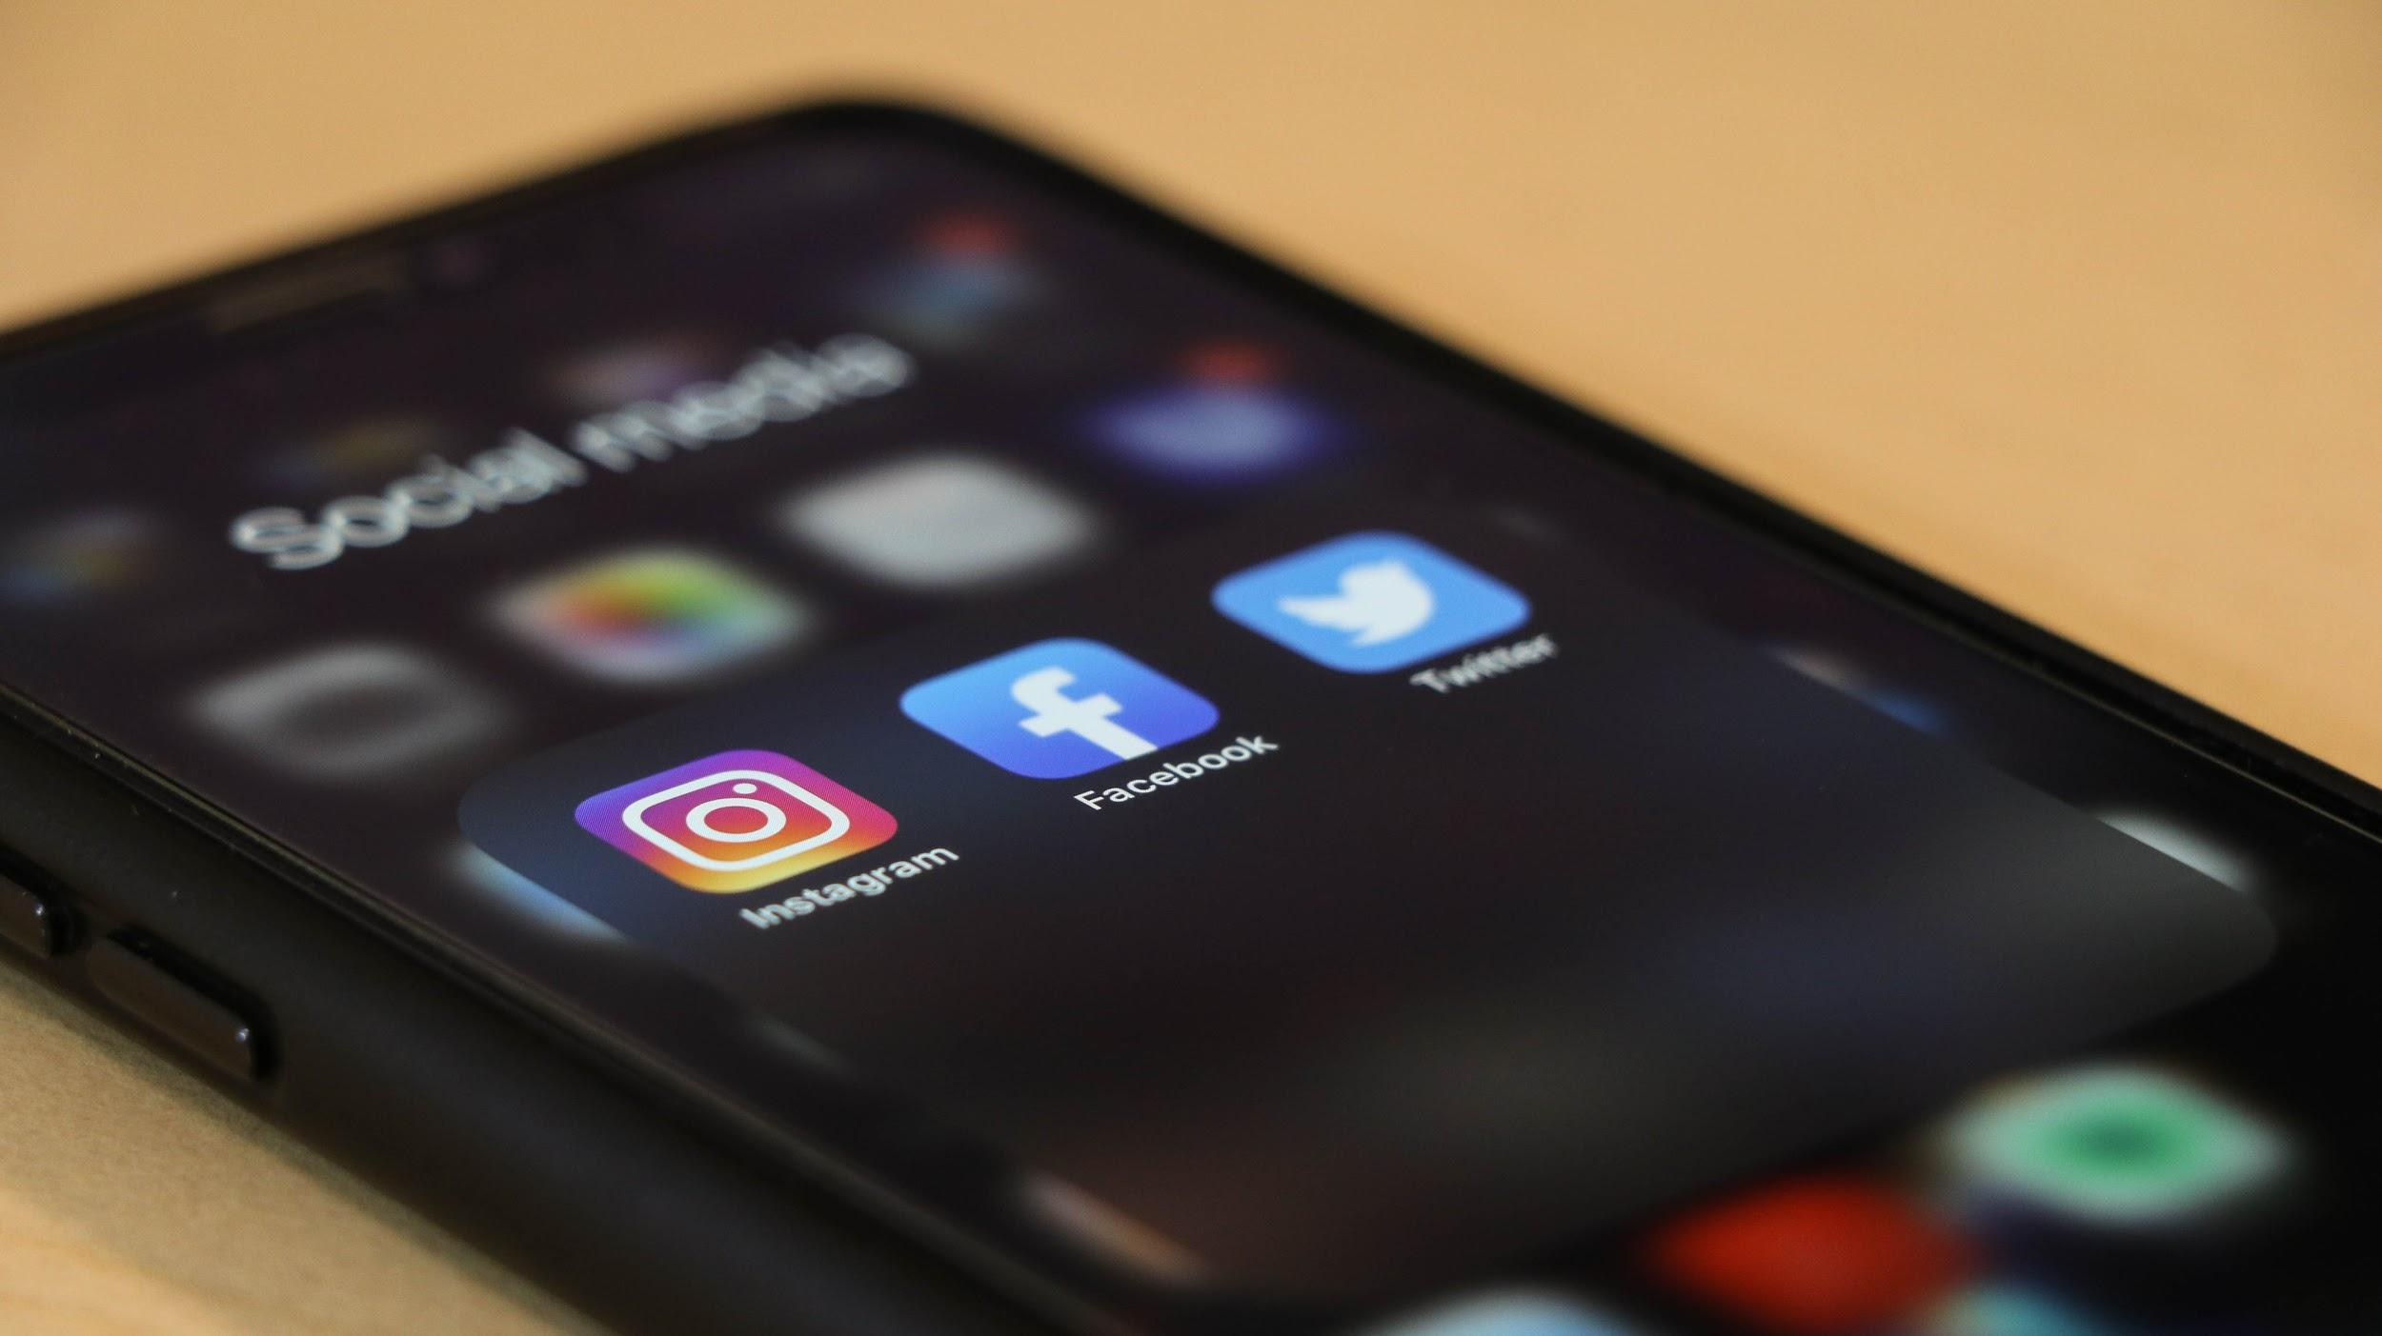
Notes:
Casey
And lastly, staying informed and updated. There are lots of resources on the internet that talk about dark patterns, such as UX Twitter feeds, Reddit forums on UX Design, UX Design podcasts, and more.

Slide 62
For your friends/family
Notes:
Casey
Finally, what you can do for friends and family.

Slide 63
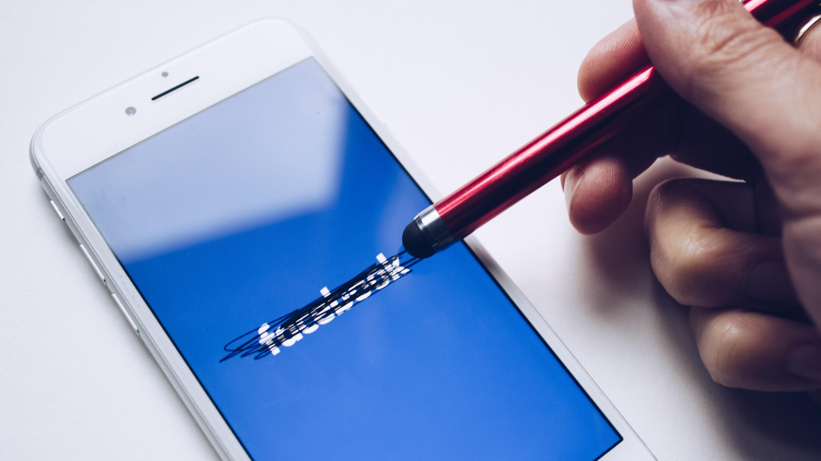
Notes:
Casey
For your friends and family, assuring them that dark UX is real and it might appear more than they might think, and that it is typically a result of shady business strategies. Making sure that they are aware of the impact of dark UX can protect them from potentially harmful consequences regarding their personal data.

Slide 64

Notes:
Casey
One way to inform your friends and family is by talking about the dark patterns that you’ve learned about and come across. They might be able to relate to certain situations or realize that they are in a situation with similar practices.

Slide 65
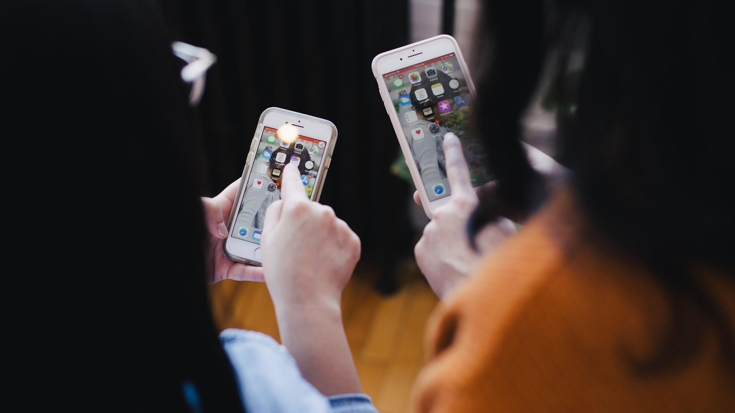
Notes:
Casey
And lastly, sharing resources with them to help them stay updated. For example, sharing this talk! Or sharing the other resources that we’ve mentioned - Reddit forums, darkpatterns.org, Twitter hashtags, etc.

Slide 66
Thank you!
Amanda
Bassett
Ian
Geiman
Mariah
Jacobs
Casey
Tin
Notes:
Thanks for listening to our presentation; we hope you’ve learned more about the dark side.

Slide 67
Questions?
#midcamp at sli.do

Slide 68
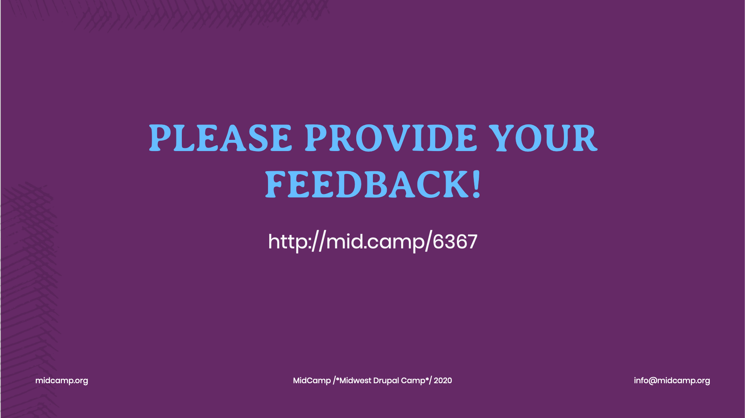

Slide 69
